Slide 1
Reddit Sarcasm Detection
1/29/2021

Slide 2
Problem
We want to take advantage of Reddit, a prolific social media website and app
It has more than 48 million active users and around 1.5 billion visits per month

Slide 3
Problem
Internet Slang and Sarcasm is abundant on Reddit
User sentiment cannot be analyzed at this scale without using a script
Scripts cannot discern sarcasm from truth

Slide 4
Approach
Reddit users conveniently use “/s” at the end of their comments to denote sarcasm
Scrape comments from the Reddit API, and clean the dataset into a supervised classification problem
“Because clearly, dough bakes in the ovens of Chicago differently than anywhere else on the planet. /s” - u/AmazingSyco

Slide 5
Some Interesting Facts
Sarcastic comments are “liked” more on average
Sarcastic comments are longer on average
Sarcastic comments are more present on political subreddits

Slide 6
Sentence-Level LSTM Model
InputLayer
Flatten
Embedding Layer
Dense (100)
Bidirectional(LSTM)
Dense (1)
TimeDistributed(Dense)

Slide 7
Model Selection
Sarcastic Comments often use juxtaposition to imply a different meaning
This uses context a lot more than “key phrases”

Slide 8
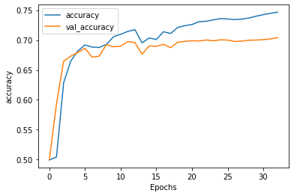
Results

Slide 9
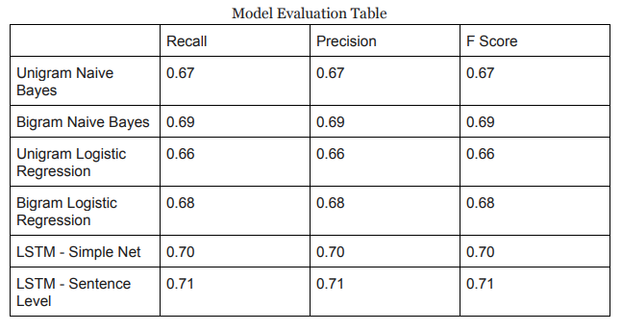
Results

Slide 10
Future Work
More information with more context:
Use parent comment to compare with reply comment
Concatenate multiple types of data
Lexical density, score, comment length

